Slide 1
The Art Oracle. Recommending art to users based on their movie preferences.
15.774 Analytics of Operations
The Three* Datateers
*number of Datateers subject to change
Notes:
Melinda

Slide 2

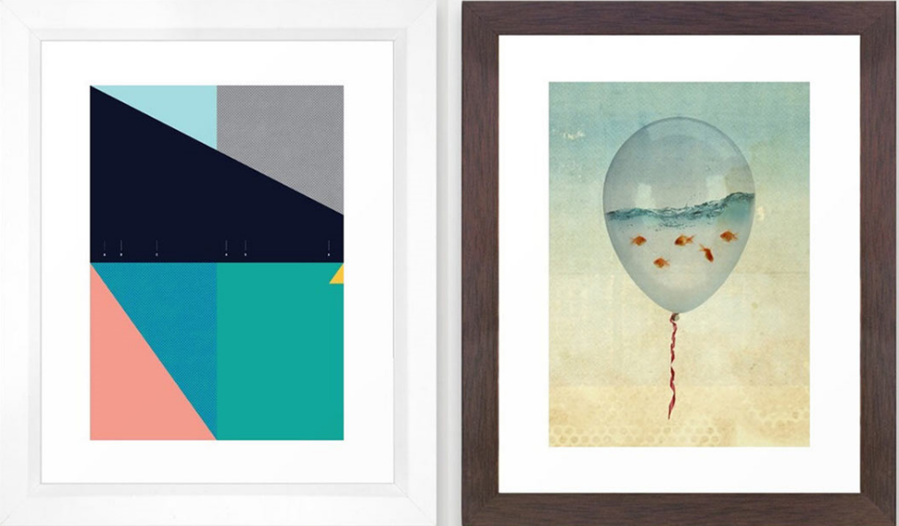

How we started.
What if we can make art recommendations based on music?
What if we used the Netflix movie database to recommend art?
Notes:
Melinda

Slide 3



Where we found data.
48
Student rankings of 39 paintings from different movements
~500,000
User rankings of 175,000+ movies through 2005
How we sourced data:
Chose Qualtrics based on capabilities and cost
Showed survey takers 10 movies and 10 pieces of art to assign ranking
Spread to personal networks via Facebook
Spent coin on Amazon Mechanical Turk
200+
Rankings of selected art and movies to build database ‘key’
100
Films from dataset of 26M; picked films most-rated in English
Notes:
Mark

Slide 4
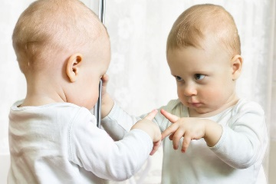
Our core assumption.
“People are likely to appreciate art, music, and movies that people similar to them enjoy.”
User-based collaborative filtering
Notes:
Mark

Slide 5
What we did.
1
Collect movie and music preferences via short survey where options randomized
Remove nonsensical responses (i.e., all the same response, all 0-responses, etc.)
2
3
Remove user bias from survey by subtracting mean score from responses
Calculate user similarities for through the cosine similarity score method
4
5
Predict user ratings for art where responses are absent (i.e., they didn’t rate)
Recommend paintings to users based on art that is predicted to have high rating
6
7
Test model validity; compare predictions against real ratings for 20% of dataset

Slide 6
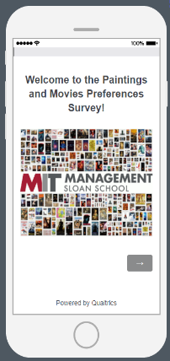
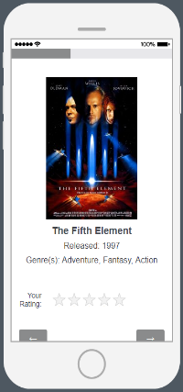
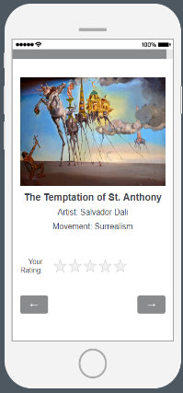
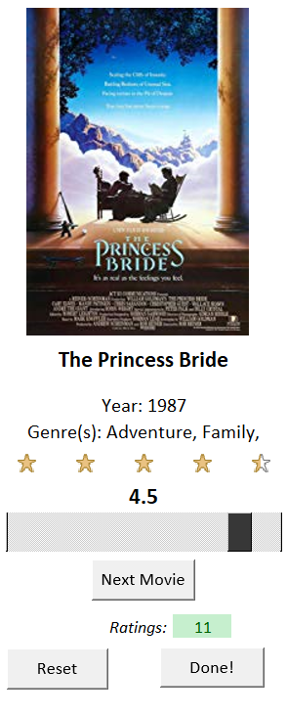
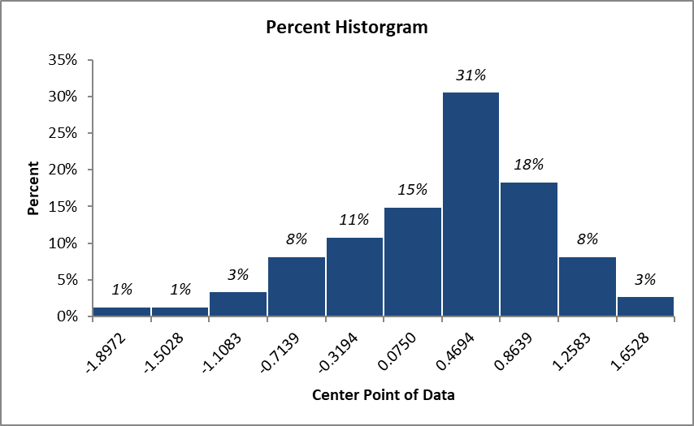
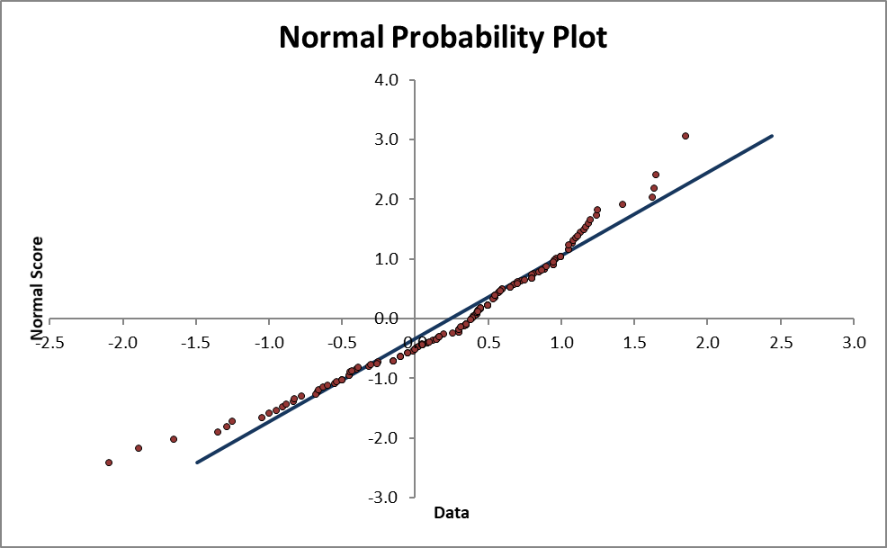
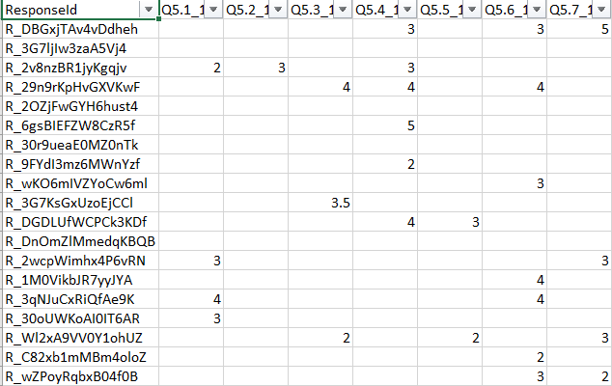
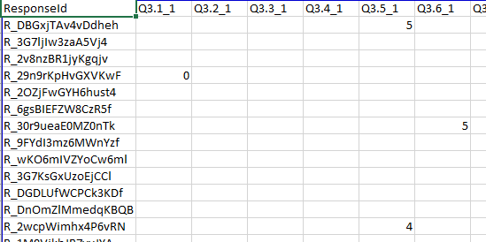
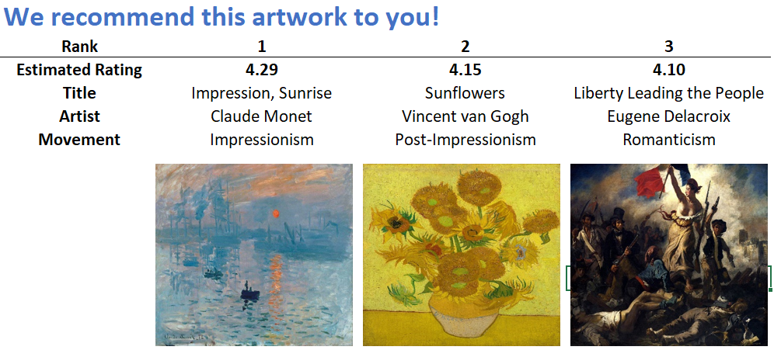
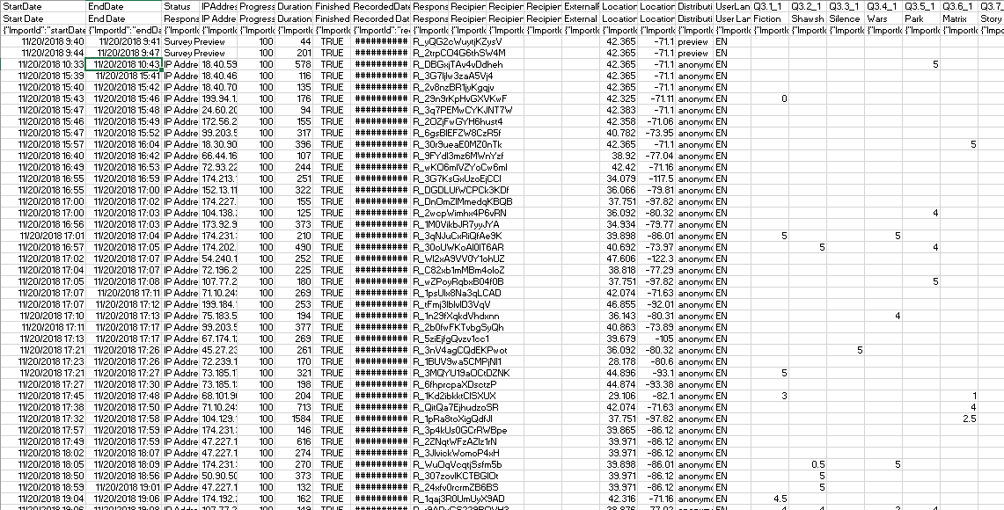
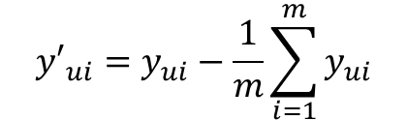
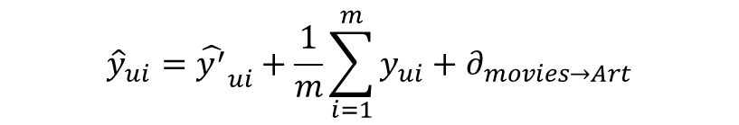

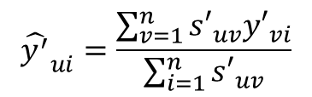
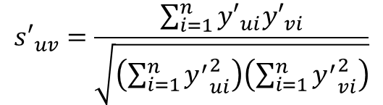
What we did.
$${s′}_{uv}=\frac{\sum_{i=1}^{n}{{y′}_{ui}{y′}_{vi}}}{\sqrt{\left(\sum_{i=1}^{n}{{y^{′}}_{ui}^{2}}\right)\left(\sum_{i=1}^{n}{{y^{′}}_{vi}^{2}}\right)}}$$
$${\hat{y^{′}}}_{ui}=\frac{\sum_{v=1}^{n}{{s′}_{uv}{y′}_{vi}}}{\sum_{i=1}^{n}{{s′}_{uv}}}$$
4
5
$${\hat{y}}_{ui}={\hat{y^{′}}}_{ui}+\frac{1}{m}\sum_{i=1}^{m}{y_{ui}}+∂_{movies→Art}$$
$${y′}_{ui}=y_{ui}−\frac{1}{m}\sum_{i=1}^{m}{y_{ui}}$$
3
1
6
2
7
$$MSE=0.87$$
Notes:
Ayano
Tomoko – removing nonsense entries (no ratings, all 5 etc) : 200+ answers → 180 valid answers → divide them to training/test
Mark
James
James
Tomoko: here is our model and visual interface you will see in a minute!
Tomoko: To check predictive power of our model, we did cross validation. 5 different test datasets and calculated MSE, Average of 5 was 0.87

Slide 7
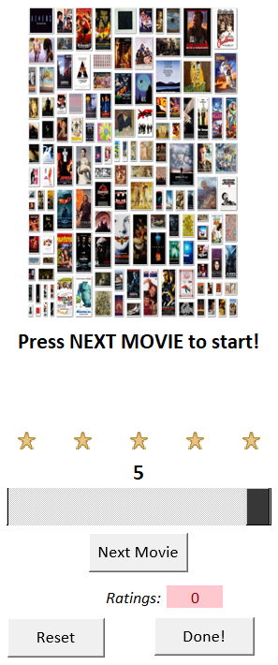
Let’s give you a demo.
Notes:
James

Slide 8
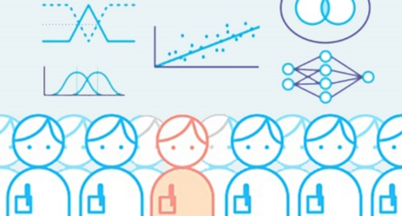


What’s next for the idea.
Give back to community. Share our combined dataset of movie and art preferences with Kaggle for more research.
Collect more art features. We have two features for each piece of art: art movement and artist. Need more for analysis.
Test alternative methods. We did user-based collaborative filtering, but want to test item-based collaborating filtering.
Notes:
Ayano

